Slide 1

Introduction to RNA-Seq: Quality Control
Wandrille Duchemin

Slide 2
"Raw data": FASTQ format
@HWI-ST143:498:D0T4GACXX:7:1101:1474:2111 1:N:0:TGACCA
TCTCNAGATAAAATCAAAACCAACAGAGAGTCTAGAATAAAAGTGAATAG
+
@@BF#2ADHHHHHJJJJIJJJJJJIJGJIJHIIGIHIIIIIJJHIHIJJJ
@HWI-ST143:498:D0T4GACXX:7:1101:1424:2149 1:N:0:TGACCA
CAGATGTTTTGGTAAGAAGAATGCCATTAGCAATTGGTGGAGGAGCAGGA
+
BBCFFFEFHHHHHJIJIJJHIIJIIJJJJJJJJJJIJHIJIJJIJIGIIG
Paired data: two separate files for forward and reverse with same ordering

Slide 3
"Raw data": FASTQ format
Read ID line starts with @
@HWI-ST143:498:D0T4GACXX:7:1101:1474:2111 1:N:0:TGACCA
TCTCNAGATAAAATCAAAACCAACAGAGAGTCTAGAATAAAAGTGAATAG
+
@@BF#2ADHHHHHJJJJIJJJJJJIJGJIJHIIGIHIIIIIJJHIHIJJJ
@HWI-ST143:498:D0T4GACXX:7:1101:1424:2149 1:N:0:TGACCA
CAGATGTTTTGGTAAGAAGAATGCCATTAGCAATTGGTGGAGGAGCAGGA
+
BBCFFFEFHHHHHJIJIJJHIIJIIJJJJJJJJJJIJHIJIJJIJIGIIG
sequence
quality line
Paired data: two separate files for forward and reverse with same ordering

Slide 4
"Raw data": FASTQ format - header
Filter
Y/N
Run
ID
Flow cell lane
Cluster
X,Y
Control
bit
@HWI-ST143:498:D0T4GACXX:7:1101:1424:2149 1:N:0:TGACCA
Instrument ID
Tile number
Member of pair
Read barcode
Flow cell ID

Slide 5
"Raw data": FASTQ format - header
Filter
Y/N
Run
ID
Flow cell lane
Cluster
X,Y
Control
bit
@HWI-ST143:498:D0T4GACXX:7:1101:1424:2149 1:N:0:TGACCA
Instrument ID
Tile number
Member of pair
Read barcode
Flow cell ID
Depends on the sequencing technology.
It was changed several times by illumina and others

Slide 6
"Raw data": FASTQ format - quality line
TCTCNAGATAAAATCAAAACCAACAGAGAGTCTAGAATAAAAGTGAATAG
@@BF#2ADHHHHHJJJJIJJJJJJIJGJIJHIIGIHIIIIIJJHIHIJJJ
Each nucleotide is associated to a quality line

Slide 7
"Raw data": FASTQ format - PHRED score
Probability that a base is incorrect (p)
Quality (Q) = -10 log₁₀(p)
ASCII encoded
P-value | PHRED | Probability of incorrect base call | Base call accuracy
10⁻¹ | 10 | 1/10 | 90%
10⁻² | 20 | 1/100 | 99%
10⁻³ | 30 | 1/1000 | 99.9%
10⁻⁴ | 40 | 1/10'000 | 99.99%

Slide 8
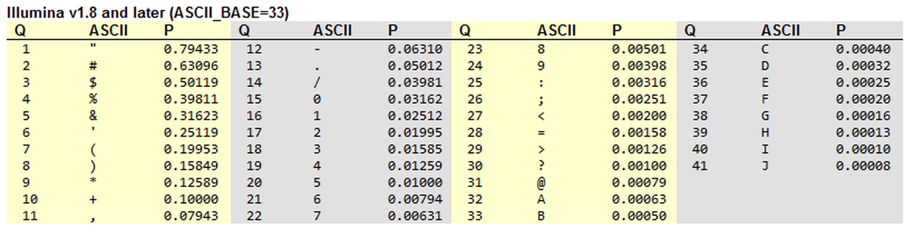
"Raw data": FASTQ format - quality line
TCTCNAGATAAAATCAAAACCAACAGAGAGTCTAGAATAAAAGTGAATAG
@@BF#2ADHHHHHJJJJIJJJJJJIJGJIJHIIGIHIIIIIJJHIHIJJJ

Slide 9
"Raw data": FASTQ format - quality line
TCTCNAGATAAAATCAAAACCAACAGAGAGTCTAGAATAAAAGTGAATAG
@@BF#2ADHHHHHJJJJIJJJJJJIJGJIJHIIGIHIIIIIJJHIHIJJJ

Slide 10
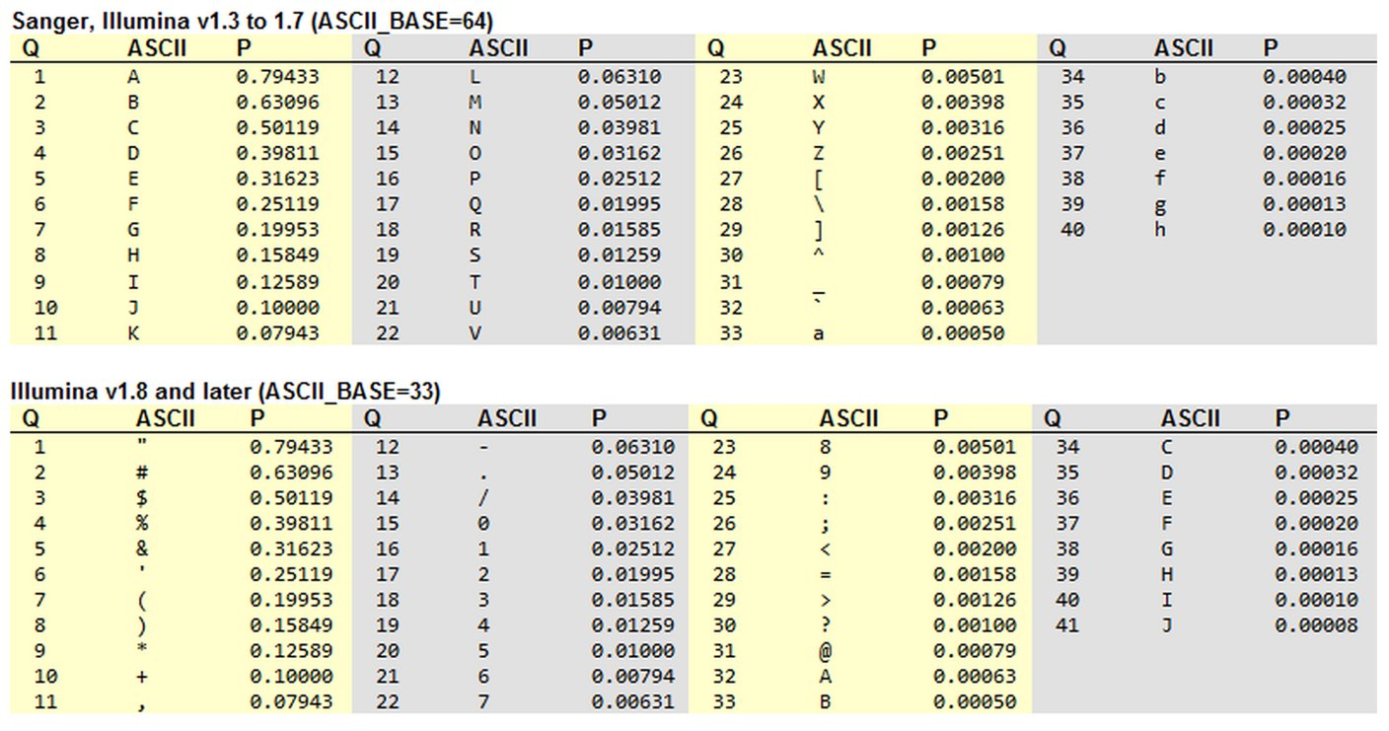
"Raw data": FASTQ format - PHRED +33/+64

Slide 11
Quality Control of FASTQ files with fastqQC
Helps spot problems in the sequencer or in starting library material
https://www.bioinformatics.babraham.ac.uk/projects/fastqc/
fastqc generates an html report :
Average quality per position
GC% profile
Adapter presence
…
Input formats: fastq (gzip), sam, bam

Slide 12
Combining multiple reports: multiQC
fastQC: 1 report for each fastq file
MultiQC: combines individual reports in a single file
https://www.multiqc.info
MultiQC also works with other tools outputs:
Trimming outputs
Mapping outputs
...

Slide 13
Practical

Slide 14
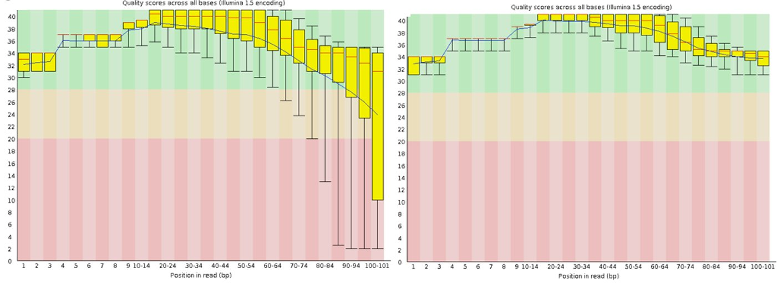
Per base sequence quality

Slide 15
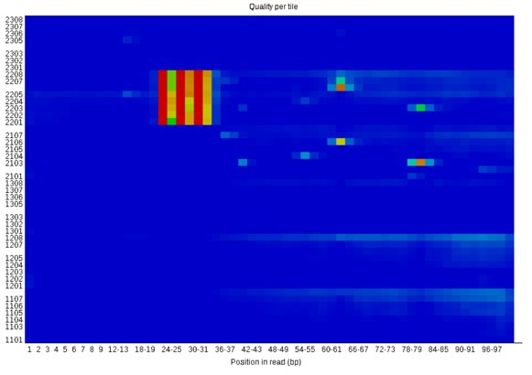
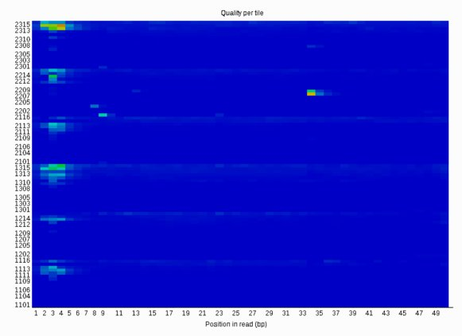
Per tile sequence quality
Only present when the fastq id contains the tile id

Slide 16
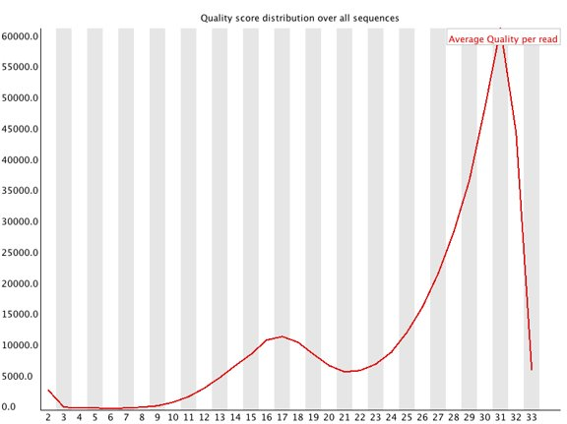
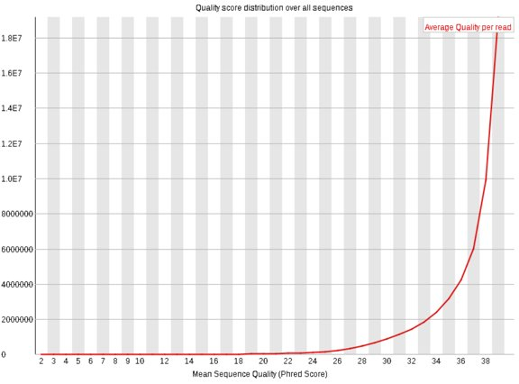
Per sequence quality score

Slide 17
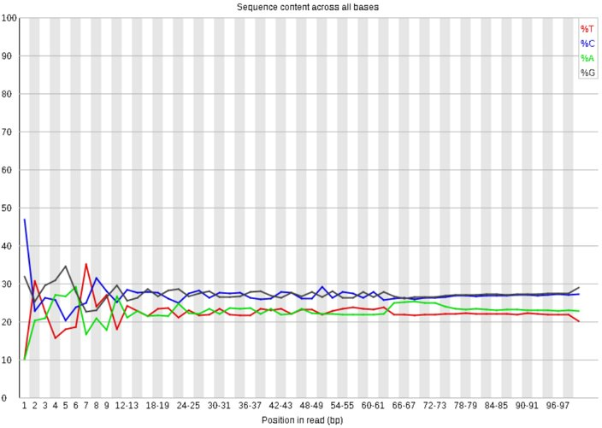
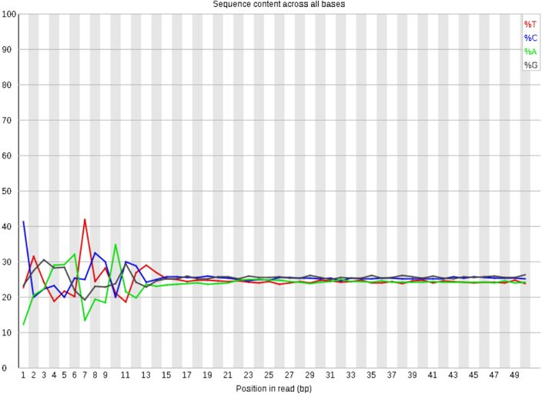
Per base sequence content

Slide 18
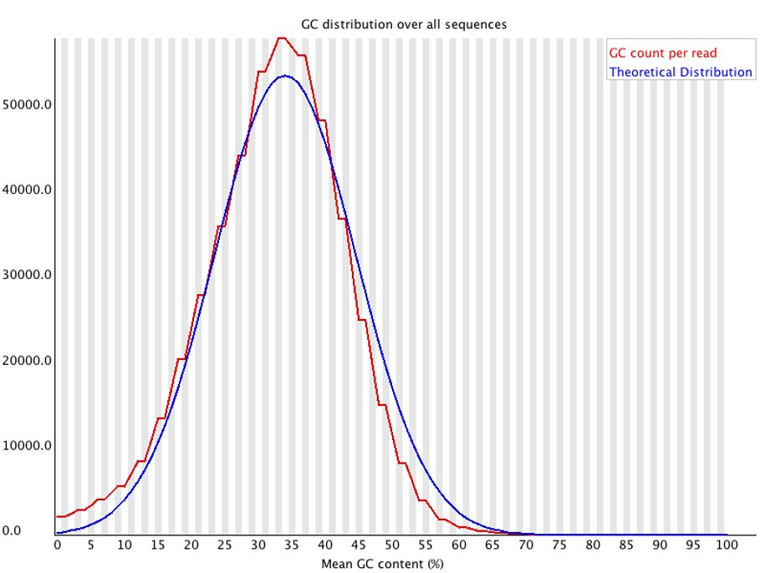
Per sequence GC content

Slide 19
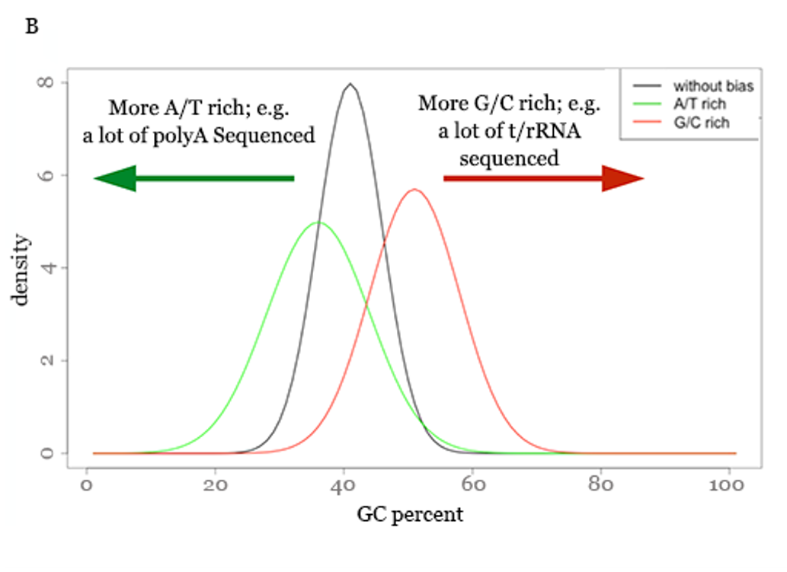
Per sequence GC content

Slide 20
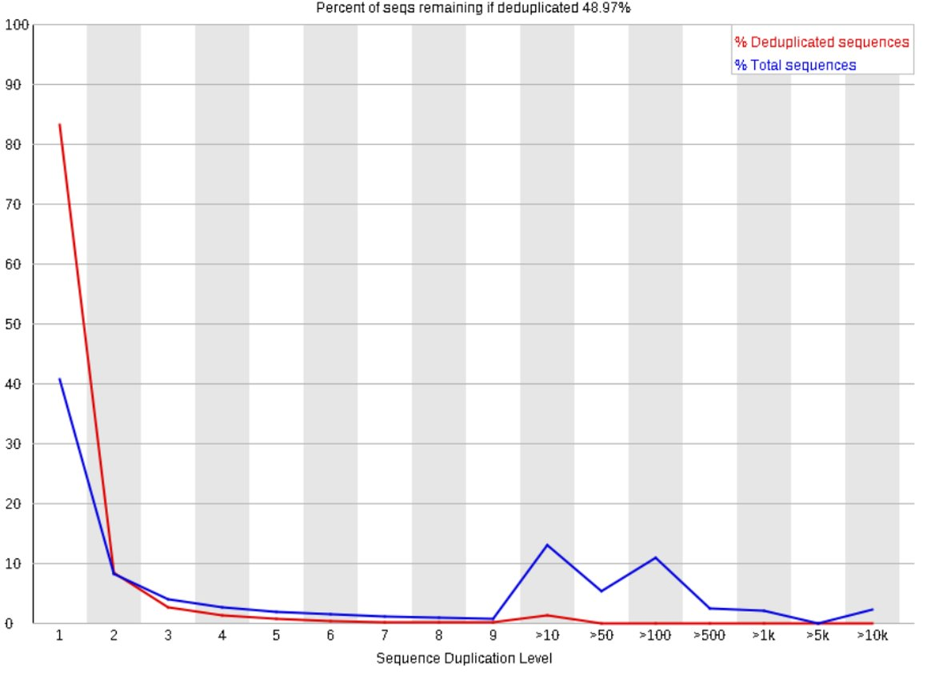
Duplicate sequences

Slide 21
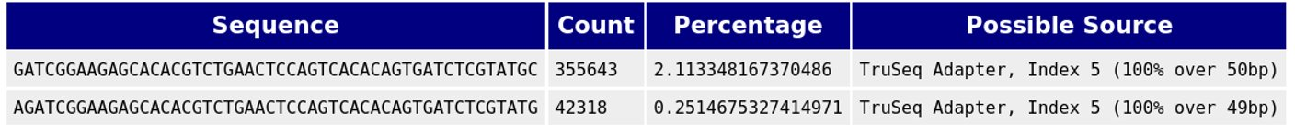
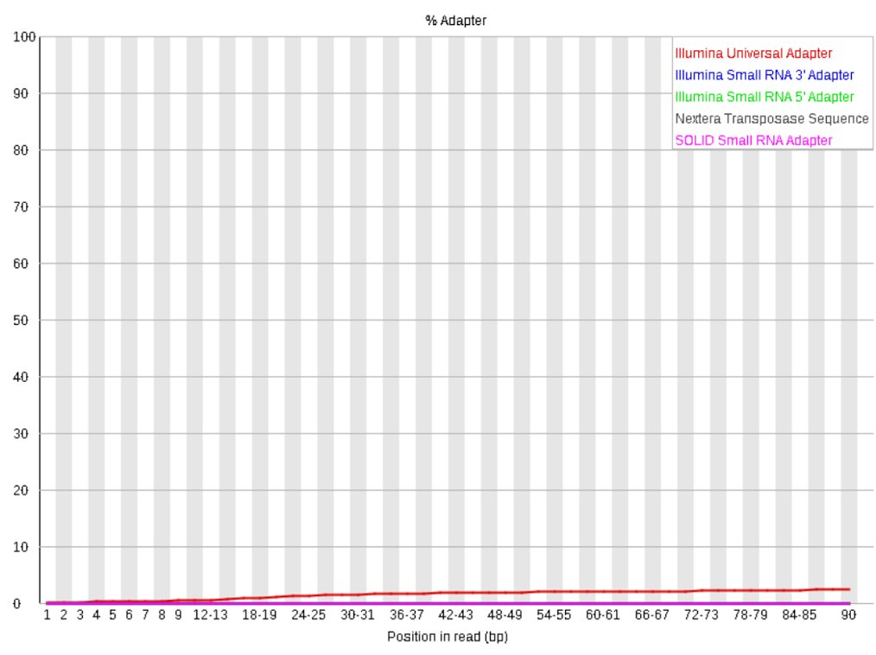
Over-represented sequences

Slide 22
Thank you

